Slide 1
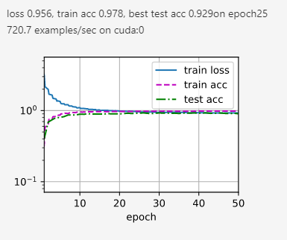
Baseline: Adam with constant learning rate

Slide 2
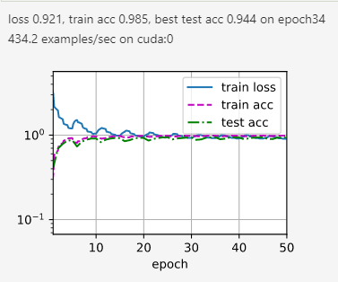
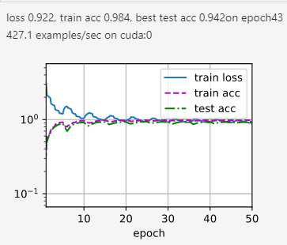
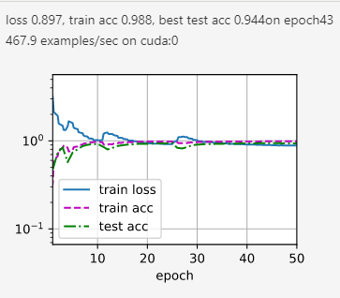
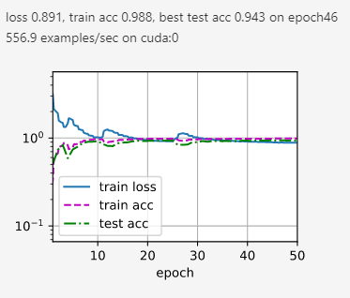
Baseline: Adam with constant learning rate
Adam with SGD T_mult=1
AdamW with SGD T_mult=1
Adam with SGD T_mult=2
AdamW with SGD T_mult=2

